Slide 2

Movies recommendation system
Vũ Minh Hiếu - 20225485

Slide 3
Content
Introduction
Dataset
Theoretical background and method
Result

Slide 4
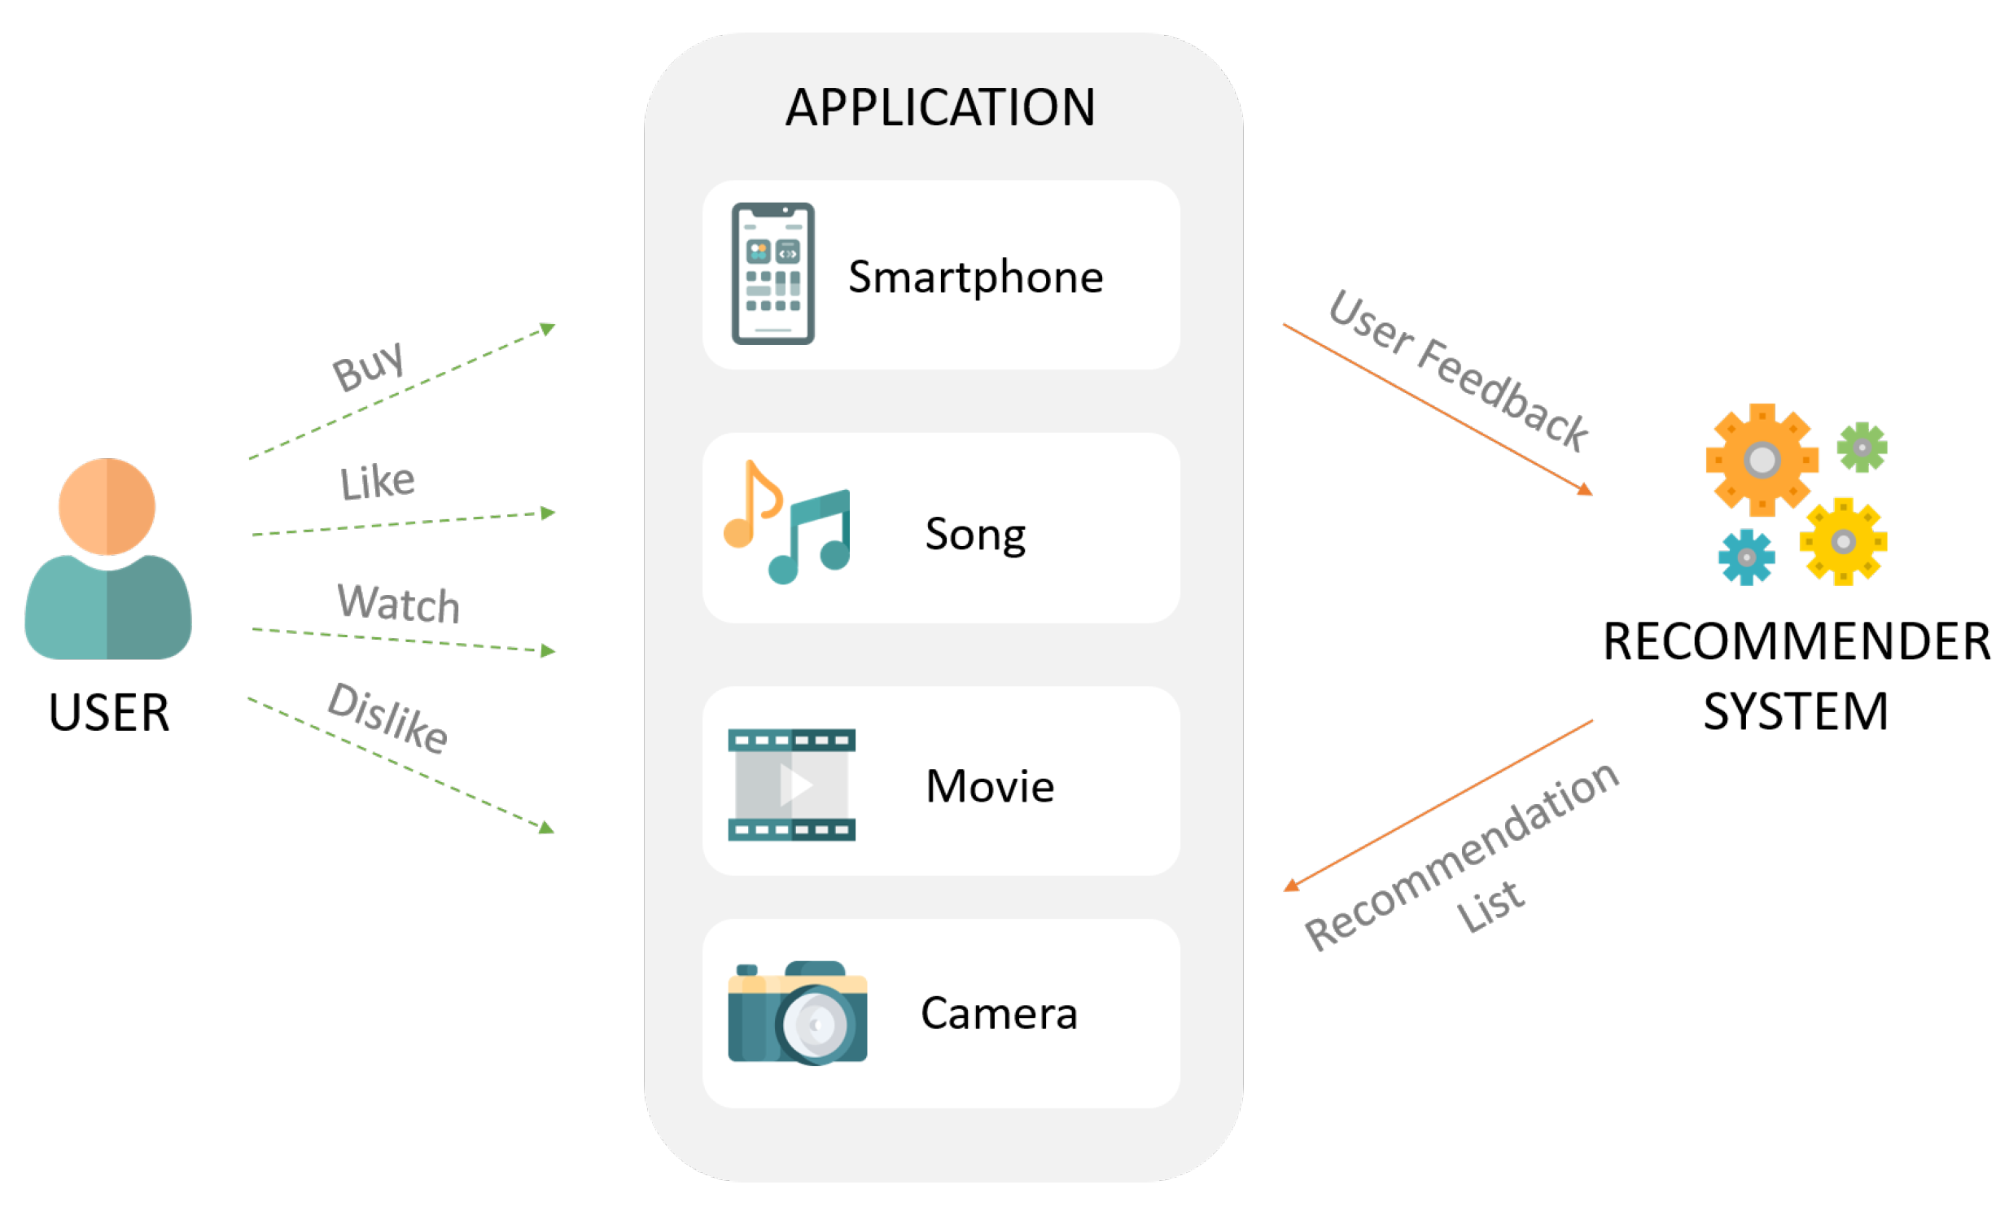
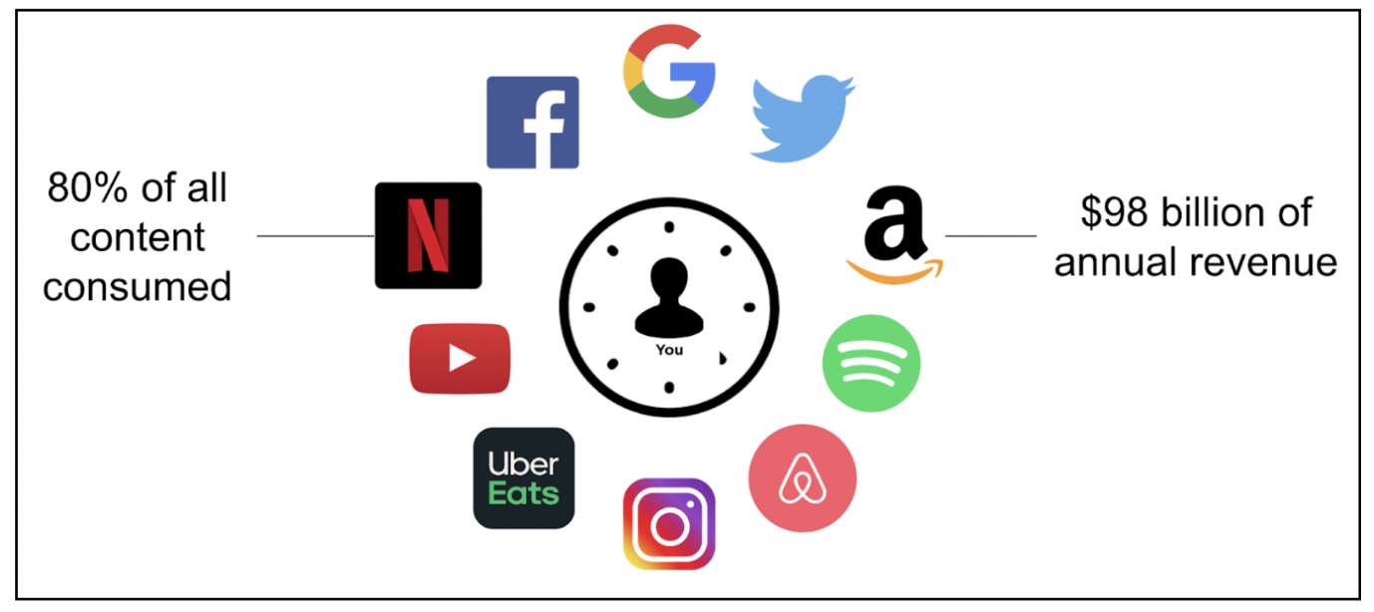
1. Introduction
A class of machine learning that uses data to help predict what people are looking for among a large number of options.
All major business utilize a recommendation system to some extend
This project study and demonstrate some popular recommendation algorithm on a movies data base and discuss theirs advantages, drawbacks and address some further improvement.

Slide 5
2. Dataset
The Movies Dataset
Metadata for all 45,000 movies: cast, crew, plot keywords, revenue, release dates, languages, production companies, TMDB vote counts, vote averages…
26 million ratings from 270,000 users. Ratings are on a scale of 1-5 and have been obtained from the official GroupLens website.

Slide 6
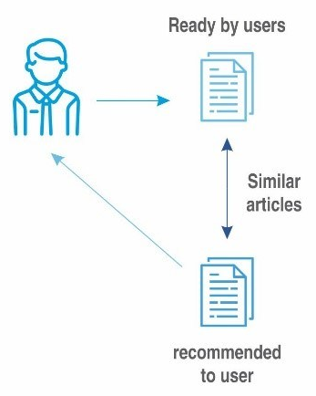
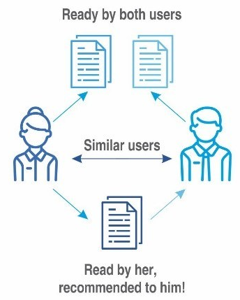
3. Theoretical background and method
Content-Based Filtering
Recommends books based on features (genre, author, description)
Example: If a user likes “Iron-man 1," they might get recommendations for “Iron-man 2"
Collaborative Filtering
Based on user behavior and preferences of similar users
Example: People who liked The Matrix also watch John Wick

Slide 7
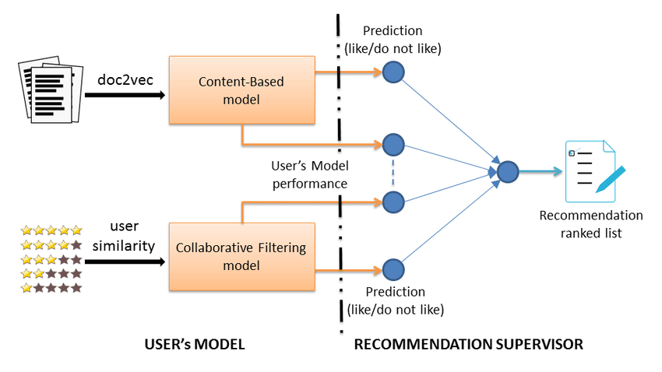
3. Theoretical background and method
Hybrid recommender
collaborative filtering: lack information about the domain dependencies
content-based system: lack information about the people’s preferences in.
=> Combine both methods to get better result.

Slide 8
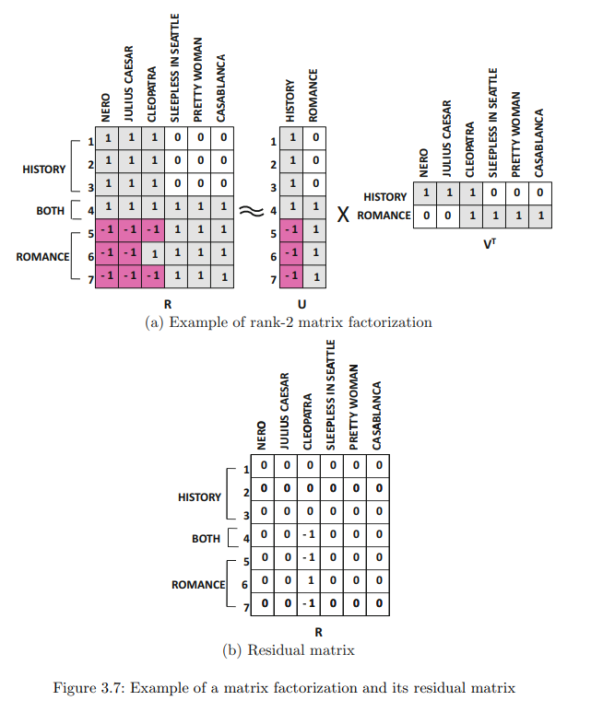
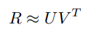
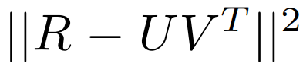
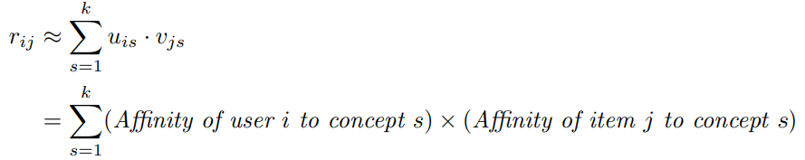
3.1. Collaborative Filtering
Latent factor model
Matrix Factorization: the m x n ratings R with rank y matrix is approximately factorized into an m x k matrix U and an n x k matrix V, where k < y:
The error of this approximation is equal to:
The i-th row u_{i} of U: user factor, contains k entries corresponding to the affinity of user i towards the k concepts in the ratings matrix.
The i-th row v_{i} of V: item factor, represents the affinity of the i-th item towards these k concepts.

Slide 9
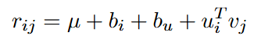
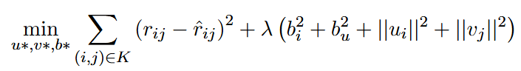
3.1. Collaborative Filtering
Matrix Factorization Algorithm
Many matrix factorization methods exist, the key differences is
the constraints imposed on U and V (e.g., orthogonality or non-negativity)
The nature of the objective function (e.g., minimizing the Frobenius norm or maximizing the likelihood estimation).
Unconstrained Matrix Factorization with bias:
Construct user-item matrix from the data
Model the rating as:
Random initialize the U and V matrix
Minimize the loss function over the set of known ratings:

Slide 10
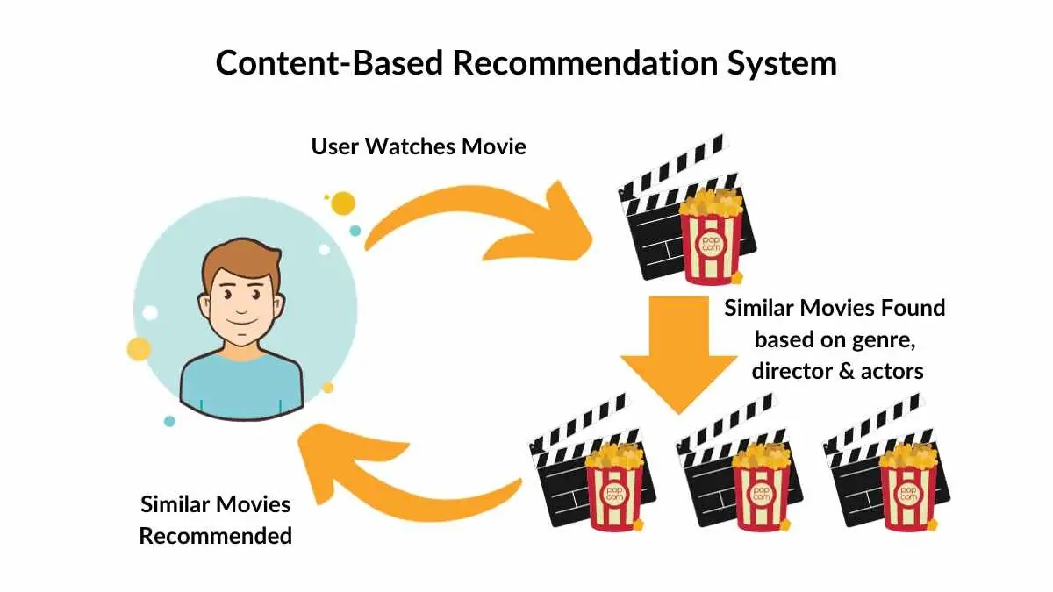
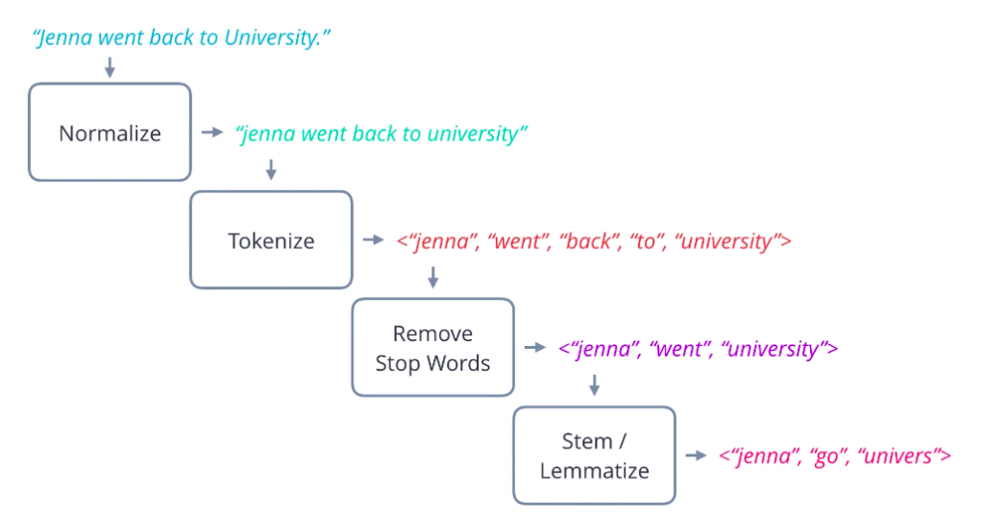
3.2. Content-Based Filtering
Basic component of Content-Based Systems:
Preprocessing and feature extraction
Content-based learning of user profiles
Filtering and recommendation
Features are extracted from various sources (description, tags, ...) and converted to a keyword-based vector-space representation
Cleaning methods:
Stop-word removal
Stemming
Phrase extraction

Slide 11
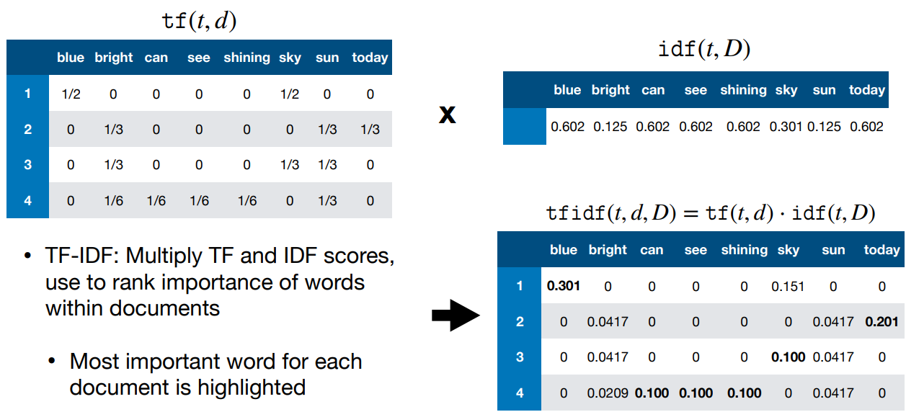
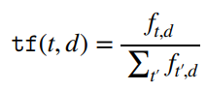
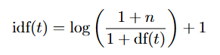
3.2. Content-Based Filtering
Tf-idf matrix
TF-IDF vector
Compute a similarity score
Dot Product
Cosine similarity
Regression models
Linear regression
Ridge regression

Slide 12

3.2. Content-Based Filtering
Ratings and metadata combines method
Concatenate top actors average ratings, movie average ratings and one-hot encoded genres.
This vector is passes through a regression model similar to word embedding based method.

Slide 13
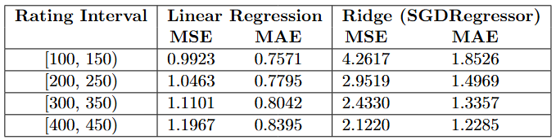
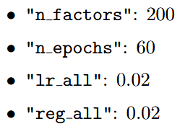
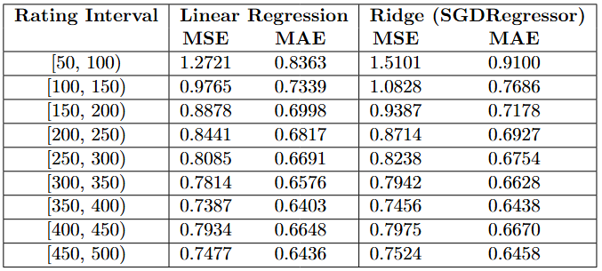
4. Result
Collaborative Filtering
MSE: 0.7419 and MSE: 0.7420 for rounded prediction
Content-Based Filtering
Word embedding based method
Ratings and metadata combines method

Slide 14
5. Challenges and future works
Challenges
Cold Start Problem: system has insufficient data about new users or new items
Sparsity of the User-Item Matrix: weakens the reliability of collaborative filtering techniques, especially matrix factorization, as the model has fewer data points to learn latent features
Scalability
Evaluation Difficulties
Data Quality and Inconsistency: In practice, textual data (such as movie descriptions, genres, and tags) can be inconsistent, or noisy
Future work
Integration of deep learning models
Developing new recommendation metric is also crucial
Leveraging multimodal data, such as movie posters, trailers, and audio features, alongside textual metadata.

Slide 15
5. Challenges and future works
Future work
Self-supervised learning (SSL) using data augmentation
Contrastive methods: learn by maximizing the agreement between different augmented views of the same data point
Generative methods: corrupt a portion of the input data and train the model to reconstruct the original, uncorrupted version.
Predictive methods: generate new training samples or pseudo-labels from the original data to serve as supervision signals for the pretext task.
Hybrid methods: combine multiple types of self-supervised tasks, to leverage different forms of supervision signals.

Slide 16
THANK YOU !

